Slide 1
DATA 542 · SPRING 2026
Advanced Clustering:
NHANES 2017-2018 Health Data
A comparative evaluation of K-Means, DBSCAN, and Gaussian Mixture Models on demographic, physiological, and metabolic data.
Presented By
Banira Acharya Dhakal
Segan Foster
Monique Handsom

Slide 2
INTRODUCTION · PROJECT OVERVIEW
02 / 14
Finding hidden health profiles in survey data
Clustering is unsupervised. This allows the revelation of patterns the data already contains.
Dataset: NHANES 2017–2018 subset, ~5,800 observations after cleaning.
Variables: age, income, BMI, systolic and diastolic blood pressure, HbA1c.
Goal: identify meaningful health profiles such as diabetes, cardiovascular, obesity-related, and lower-risk groups.
Approach: compare three methods that group data differently — by distance, density, and probability.
NHANES data does not already define health risk groups. Clustering identifies natural groupings without predefined labels.
Individuals vary across age, income, weight, blood pressure, and glucose. Clustering helps surface those natural groupings without forcing predefined labels — useful for screening, prevention, and targeted intervention.

Slide 3
EDA · SUMMARY STATISTICS
03 / 14
Variables span very different scales
Center, spread, and shape for each numeric variable — pre-scaling, pre-clustering.
VARIABLE | MEAN | MEDIAN | VARIANCE | SKEW | SHAPE
age | 48.13 | 49.00 | 383.59 | −0.04
income_pir | 2.51 | 2.07 | 2.58 | 0.35
bmi | 29.46 | 28.30 | 55.75 | 1.25
waist | 99.34 | 98.10 | 306.63 | 0.47
sys_bp | 125.13 | 122.00 | 387.48 | 1.03
dia_bp | 71.20 | 72.00 | 185.04 | −0.90
hba1c | 5.81 | 5.50 | 1.15 | 3.24
Right skew
Left skew
Symmetric
HbA1c is heavily right-skewed (3.24) — a subset with very high glucose. BMI and systolic BP show moderate right skew. Variables span very different scales, motivating z-score standardization before clustering.

Slide 4
EDA · DISTRIBUTIONS & OUTLIERS
04 / 14
Skew patterns drive imputation strategy
Three variables (BMI, sys_bp, HbA1c) show heavy right tails with outliers.
Right-skewed
Left-skewed
Symmetric
BMI, sys_bp, HbA1c
dia_bp
age
Tail extends right →
← Tail extends left
Balanced around center
Right-skewed variables drove the choice of median imputation over mean — median is robust to extreme values and preserves the typical observation.

Slide 5
EDA · MISSING DATA & IMPUTATION
05 / 14
Missingness is concentrated, not random
Income and blood pressure variables had the highest rates, so median imputation was chosen for robustness.
MISSINGNESS BY VARIABLE
WHY MEDIAN, NOT MEAN
income_pir
~12%
Several variables are skewed.
HbA1c, BMI, systolic BP have heavy right tails.
Mean is pulled by outliers.
It would shift imputed values upward.
Median is robust.
Represents the typical observation.
Verified post-imputation:
Summary statistics nearly identical to original.
sys_bp
~10%
dia_bp
~9%
bmi
~4%
hba1c
~4%
waist
~3%
age
~0%
Means, medians, and variances after imputation matched the original within rounding error. Imputation handled missingness without biasing downstream clustering.

Slide 6
EDA · VARIABLE SELECTION & SCALING
06 / 14
Drop redundancy, standardize the rest
Correlation analysis removed one variable. Categorical exclusion removed another variable.
age
inc
bmi
wst
sys
dia
a1c
DECISIONS MADE
age
1
Drop waist Highly correlated with BMI (r ≈ 0.90). Keep one to avoid redundancy.
inc
bmi
bmi × waist
r ≈ 0.90
2
Drop sex Categorical, not appropriate for distance-based clustering. Saved for profiling.
wst
sys
3
Standardize Remaining six variables to mean 0, sd 1.
dia
a1c
4
Result All variables contribute equally; no variable dominates by scale.
Six variables move on to clustering: age, income_pir, BMI, sys_bp, dia_bp, HbA1c.

Slide 7
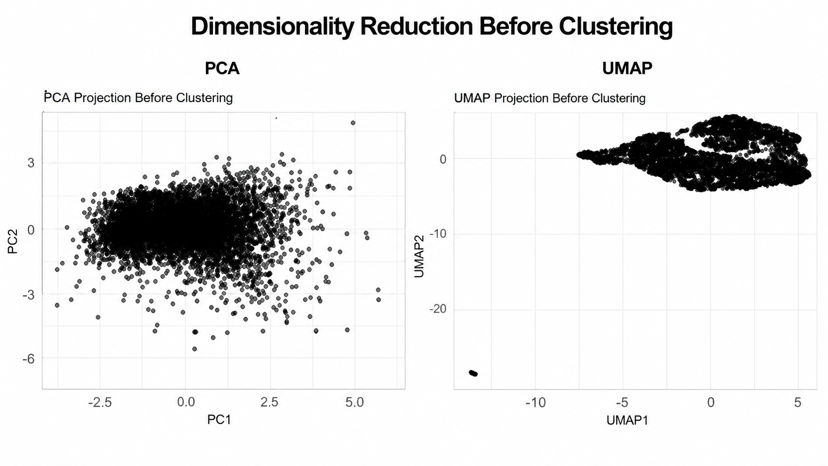
EDA · PRE-CLUSTERING VISUALIZATION
07 / 14
PCA and UMAP suggest continuous structure
PCA projection
UMAP projection
Two principal components, scaled data
Nonlinear two-dimensional embedding

Slide 8
DBSCAN · METHOD SELECTION
08 / 14
Why DBSCAN for health data
Density-based clustering with explicit handling of outliers.
01
02
03
No K required
Noise is explicit
Two parameters
DBSCAN doesn't ask us to specify the number of clusters in advance. It finds them based on regions of high density.
Low-density points are labeled as noise rather than forced into a cluster. In health data, that matters: extreme cases shouldn't be lumped with typical ones.
eps — radius of the neighborhood around each point.
minPts — minimum number of points required to form a dense region.
DBSCAN can detect unusual observations and find arbitrarily shaped clusters, but it is sensitive to parameter choice and struggles when clusters have very different densities.

Slide 9
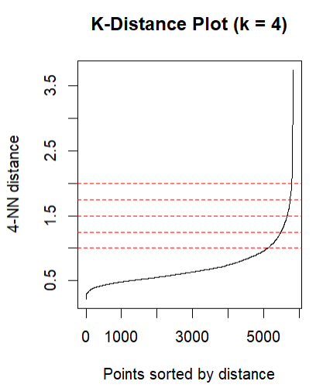
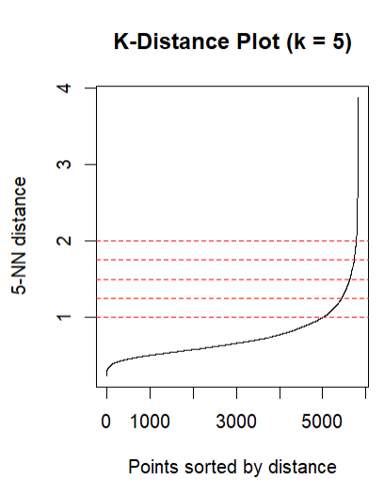
DBSCAN · CHOOSING EPSILON
09 / 14
The k-NN distance plot points to ε ≈ 1.5
Tested at two values of k to confirm the elbow isn't an artifact.
Distance to 4th nearest neighbor, sorted
Sensitivity check at a different k value
Both curves elbow in the same place (ε ≈ 1.5). The consistency across k values means the density threshold is a property of the data, not a parameter artifact. ε = 1.5 becomes our starting point for the grid search.

Slide 10
DBSCAN · GRID SEARCH
10 / 14
30 combinations tested — one stable solution
eps ∈ [1.2, 1.7] × minPts ∈ [3, 7] → ε = 1.5, minPts = 5.
Number of clusters by parameter combination
SELECTION REASONING
1.2
1.3
1.4
1.5
1.6
1.7
minPts = 5 Chosen over the standard rule (dim+1 = 7). minPts = 7 collapsed to 1–2 clusters across all ε values.
3
10
7
5
4
4
4
4
7
7
7
4
4
4
ε = 1.5 Sits in a stable region — three clusters at minPts = 5 holds for ε = 1.4, 1.5, and 1.6.
minPts
5
2
4
3
3
3
4
ε = 1.6 rejected ε = 1.7 jumps to four clusters (unstable neighbor); 1.6 too close to that boundary.
6
2
3
2
2
2
2
7
1
2
2
2
2
2
Result Three clusters + 69 noise points (1.18%) at chosen settings.
eps →

Slide 11
DBSCAN · CLUSTER SOLUTION
11 / 14
One dominant cluster, satellites, and noise
ε = 1.5, minPts = 5 — final fit.
CLUSTER 1
CLUSTER 2
CLUSTER 3
NOISE
5,728
26
5
69
98.2% of clustered obs
0.45%
0.09%
1.18% of total
PROPORTIONAL VIEW
Cluster 1 — 98.2%
The noise is not erroneous data but extreme clinical cases. The 69 noise observations fall outside the minimum density threshold of the main groups. They are real patients with unusual feature profiles, which is what DBSCAN is designed to reveal.

Slide 12
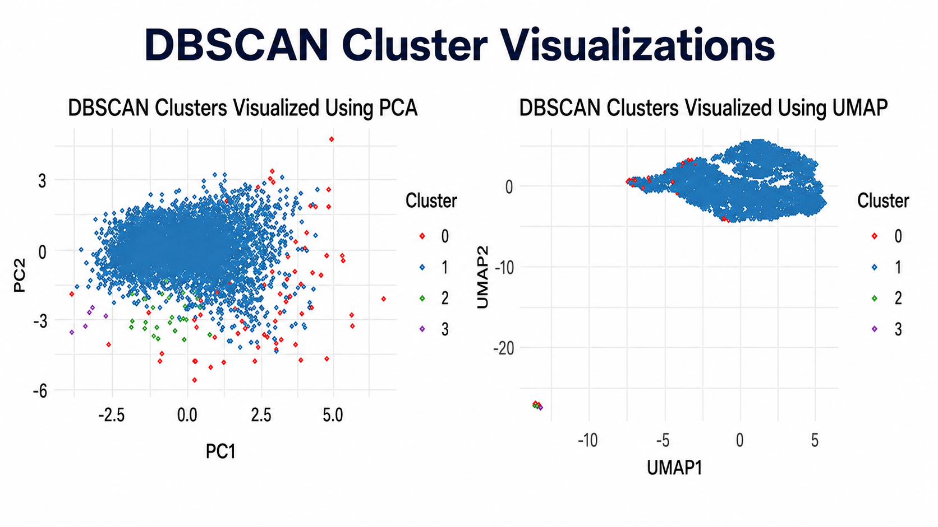
DBSCAN · CLUSTER VISUALIZATION
12 / 14
PCA and UMAP confirm the same imbalance
Both projections show one central mass with peripheral satellites and noise.
PCA — colored by cluster
UMAP — colored by cluster
Cluster 1 (5,728)
Cluster 2 (26)
Cluster 3 (5)
Noise (69)

Slide 13
DBSCAN · EVALUATION
13 / 14
Three metrics, one consistent story
Each metric is moderate in isolation but together they reveal the same limitation.
SILHOUETTE SCORE
DAVIES-BOULDIN
CALINSKI-HARABASZ
0.4811
0.7432
96.64
Moderate separation. Observations match their cluster, but boundaries are not crisp.
Lower is better. Looks acceptable but inflated by tiny clusters being dense by construction.
Modest. Sensitive to cluster balance — the imbalanced solution caps this score.
PER-CLUSTER SILHOUETTE DISTRIBUTION
CLUSTER | N | MEAN | MEDIAN | MIN | MAX | % NEGATIVE
Cluster 1 | 5,728 | 0.4815 | 0.5109 | −0.3074 | 0.6514 | 0.51
Cluster 2 | 26 | 0.3624 | 0.4103 | 0.0419 | 0.5259 | 0.00
Cluster 3 | 5 | 0.6315 | 0.6258 | 0.5743 | 0.7097 | 0.00
Cluster 3's 0.63 is misleading. Five observations almost always score well on silhouette. The metrics reflect cluster size more than genuine density structure.

Slide 14
DBSCAN · TAKEAWAY & TRANSITION
14 / 14
A meaningful negative result
DBSCAN didn't find clean structure — and that's informative.
WHAT WE LEARNED
WHAT THIS IMPLIES
30 parameter combinations tested. Everyone returned either one dominant cluster or two with similar imbalance.
If the data is continuous, density-based methods will struggle.
No substantive multi-cluster structure emerged. DBSCAN couldn't surface meaningfully sized groups.
The path forward is to use methods designed for overlapping or distance-based structure.
NHANES health profiles are continuous, not density-separated as PCA/UMAP has suggested.
GMM
K-Means
The 69 noise observations are real extreme clinical cases and are themselves valuable for further study.
Probabilistic, handles overlap.
Distance-based, balanced clusters.

Slide 15
Gaussian Mixture Models (GMM)
• GMM was used because NHANES health data represents a continuous spectrum rather than clearly separated groups.
• GMM is useful for identifying overlapping health profiles through probabilistic cluster membership.
• It can model clusters with different shapes, centers, spreads, and covariance structures.
• GMM was appropriate because the EDA showed some moderate skewness and correlated variables.
• Cluster assignment is based on probabilities estimated using the Expectation-Maximization algorithm.
• Model selection focused on comparing different covariance structures using the mclust package.
• GMM assume each cluster follows a normal distribution.
• Perform poorly when cluster doesn’t follow normal distribution.

Slide 16
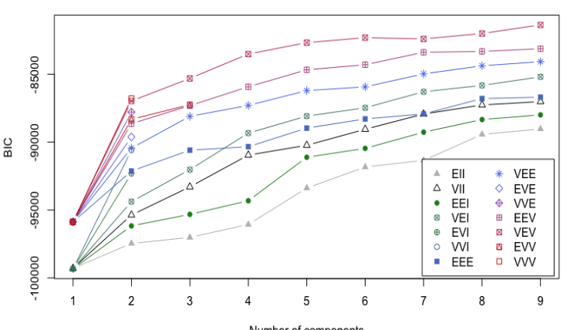

Slide 17
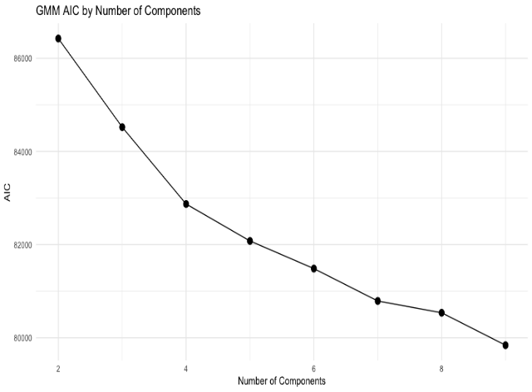
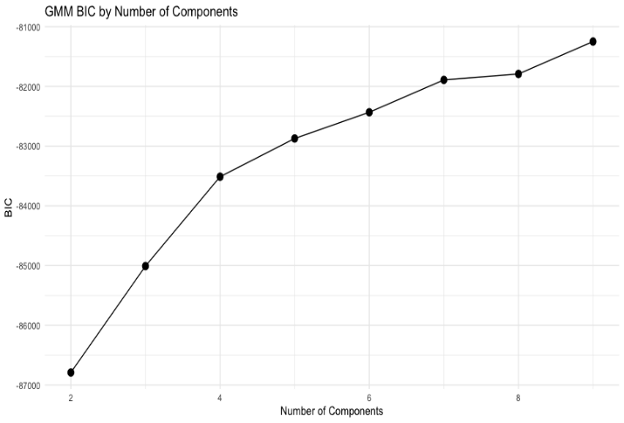

Slide 18
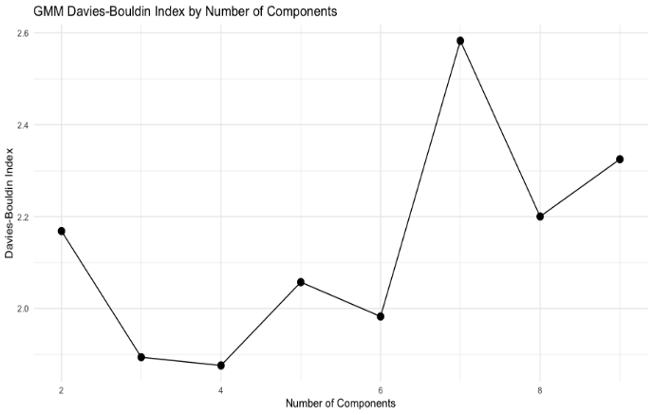
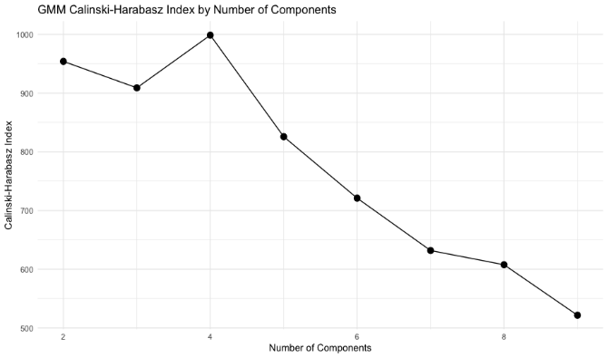

Slide 19
G | Model | BIC | AIC | Silhouette | Davies-Bouldin | Calinski-Harabasz
2 | VVV | -86790.89 | 86424.01 | 0.2461 | 2.1686 | 953.9958
3 | VEV | -85008.67 | 84521.72 | 0.1667 | 1.8939 | 908.9528
4 | VEV | -83512.20 | 82871.84 | 0.1813 | 1.8760 | 998.6605
5 | VEV | -82872.22 | 82078.44 | 0.1234 | 2.0574 | 825.7462
6 | VEV | -82433.01 | 81485.81 | 0.0997 | 1.9826 | 721.0337
7 | VEV | -81891.03 | 80790.41 | 0.0856 | 2.5829 | 631.8080
8 | VEV | -81791.56 | 80537.52 | 0.0900 | 2.2003 | 607.6264
9 | VEV | -81248.89 | 79841.42 | 0.0476 | 2.3250 | 521.5428

Slide 20
BIC | AIC | Silhouette | Davies-Bouldin | Calinski-Harabasz
-83512.20 | 82871.84 | 0.1746 | 1.9078 | 991.787
Cluster Number | Number of Observations | Average Silhouette Width
1 | 1145 | 0.2395428
2 | 823 | -0.1011910
3 | 1970 | 0.2515514
4 | 1890 | 0.1752064

Slide 21
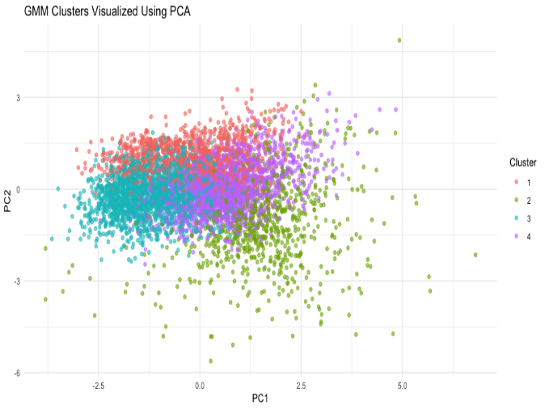
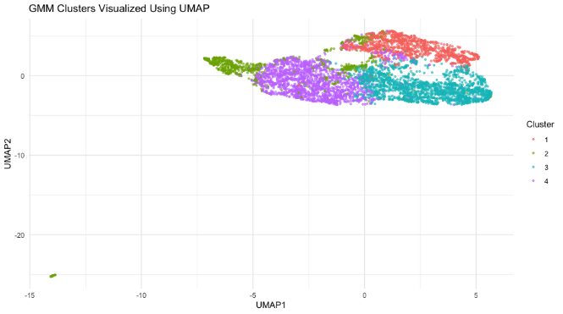

Slide 22
K-MEANS CLUSTERING ANALYSIS
• K-means was selected because it is simple, fast, widely used, and easy to interpret.
• It is appropriate for continuous numeric health variables in the NHANES dataset.
• K-means assigns each observation to the nearest cluster centroid.
• Centroids are recalculated repeatedly until cluster assignments become stable.
• The main parameter is K, or the number of clusters.
• Different K values were tested using the Elbow Method, Silhouette Score, Davies-Bouldin Index, and Calinski-Harabasz Index.
• K-means is useful for creating clear and meaningful health profiles.
K-means assumes that clusters are roughly round, similar in size, and separated by distance from their centroids.
• Its limitations include needing to choose K in advance and sensitivity to outliers and initial centroid placement.
• Final method selection was based on both validation metrics and practical interpretability.
• Cluster sizes and health profiles were examined to determine whether the results were meaningful.

Slide 23
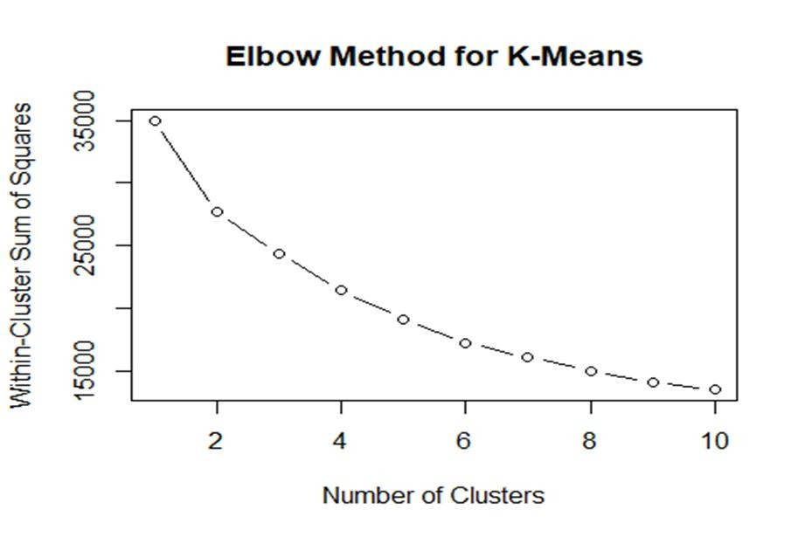

Slide 24
Validation Metrics for Different K Values K Silhouette_Score Davies_Bouldin_Index Calinski_Harabasz_Index 1 2 0.2019203 1.757493 1534.722 2 3 0.1940932 1.635532 1259.597 3 4 0.2113755 1.497466 1223.244 4 5 0.2153430 1.412943 1205.100 5 6 0.2134919 1.364325 1195.268 6 7 0.2149356 1.261704 1131.680 7 8 0.2024621 1.273045 1101.250 8 9 0.1842117 1.308878 1067.824 9 10 0.1798195 1.328546 1015.720

Slide 25
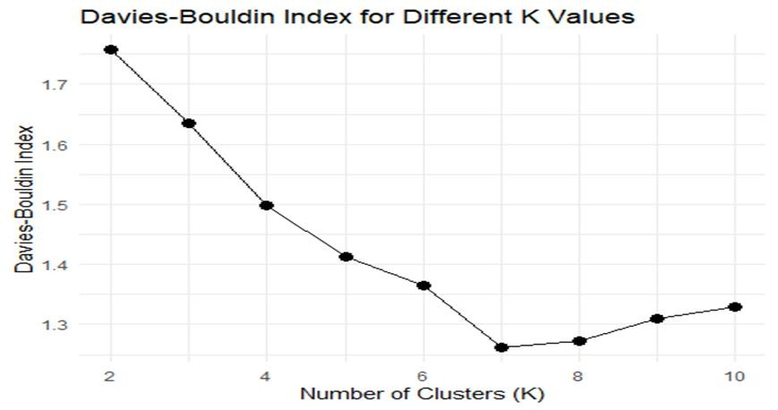
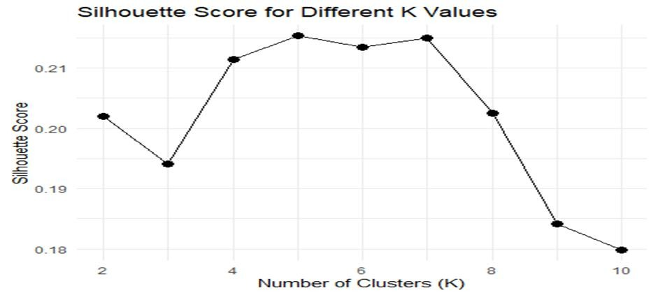

Slide 26
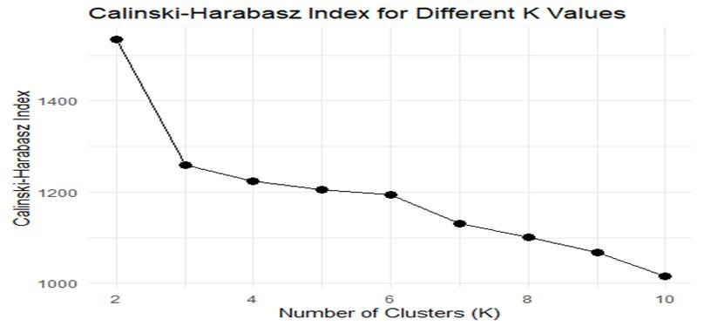
Method | Silhouette | Davies_Bouldin | Calinski_Harabasz
K-means | 0.2153 | 1.4129 | 1205.1

Slide 27
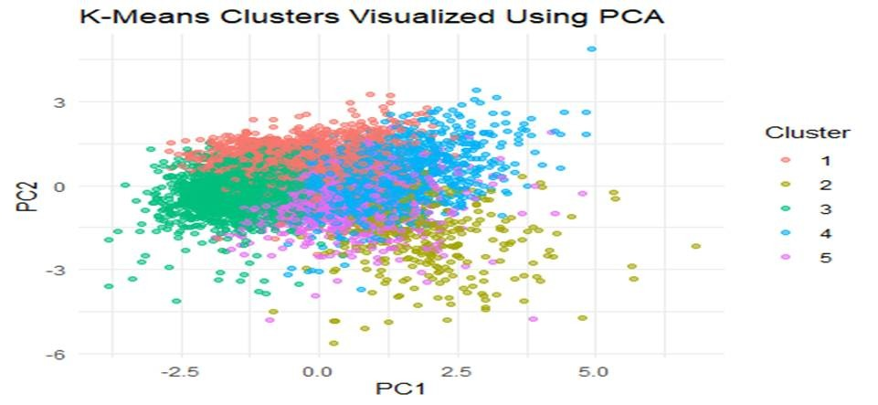
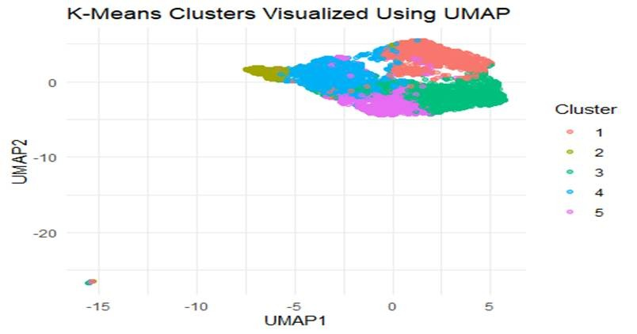

Slide 28
Comparison of Methods

Slide 29
Metrics by Clustering Method
Method | Silhouette Score | Davies-Bouldin Index | Calinski-Harabasz Index | BIC and AIC (GMM only)
K-means | 0.2153 | 1.4129 | 1205.100 | N/A
DBSCAN | 0.4811 | 0.7432 | 96.64 | N/A
GMM | 0.1746 | 1.9078 | 991.79 | -83512.20 (BIC) -82871.84 (AIC)

Slide 30
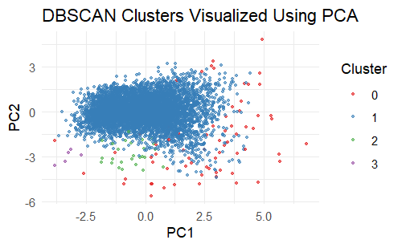
DBSCAN
Method | Silhouette Score | Davies-Bouldin Index | Calinski-Harabasz Index | BIC and AIC (GMM only)
DBSCAN | 0.4811 | 0.7432 | 96.64 | N/A
Scores highest for Davies-Bouldin index and silhouette width
Most distinct and well-separated clusters
Very low Calinski-Harabasz index, likely due to the non-spherical cluster shapes
Dominated by cluster 1 with 5,728 observations while cluster two has 26 and cluster three has 5

Slide 31
GMM
Method | Silhouette Score | Davies-Bouldin Index | Calinski-Harabasz Index | BIC and AIC (GMM only)
GMM | 0.1746 | 1.9078 | 991.79 | -83512.20 (BIC) -82871.84 (AIC)
Performed the worst for both silhouette score and the Davies-Bouldin index
Least distinct clusters, with overlap between all clusters
Cluster two has a negative silhouette width, indicating that its members may belong to a different natural grouping
The Calinski-Harabasz index is much higher than we saw with DBSCAN, as the GMM produced more spherical clusters
The cluster sizes are much more reasonable and balanced

Slide 32
K-Means
Method | Silhouette Score | Davies-Bouldin Index | Calinski-Harabasz Index | BIC and AIC (GMM only)
K-means | 0.2153 | 1.4129 | 1205.100 | N/A
Performed between the two prior models for both silhouette score and the Davies-Bouldin index
Cluster are better separated with less overlap when compared to GMM
Cluster sizes remain balanced compared to DBSCAN
The Calinski-Harabasz index is the highest of all three methods, due in part to the spherical clusters produced by K-Means

Slide 33
Selecting the Best Method
While DBSCAN had metrics indicating that it had produced the highest quality clusters, It’s enormous imbalance in cluster sizes does not allow us to distinguish between natural groupings withing the data set
The GMM method produced the least-separated clusters with high overlap, so we will not select this method either
The K-means method provided modest validation scores, but outperformed GMM while maintaining balanced clusters, making it our chosen “best method”

Slide 34
Cluster 1 Profile
Represents high-income participants with moderate health
Highest income to poverty ratio
Moderate values of BMI, blood pressure, and HbA1c
Participants with high socioeconomic status may have better access to healthcare, nutrition, and preventative services

Slide 35
Cluster 2 Profile
Represents a group with high diabetes risk
Highest scores for HbA1c, indicating poor glucose regulation, increasing risk of diabetes
This group could benefit from diabetes screening, lifestyle intervention, and chronic disease management

Slide 36
Cluster 3 Profile
Represents the group of young, healthy participants
Lowest mean age
Lowest values for BMI, blood pressure, and HbA1c
Participants in this cluster are at low cardiovascular risk and low risk of diabetes

Slide 37
Cluster 4 Profile
Represents older participants with cardiovascular risk
Highest average age
Highest systolic blood pressure, often associated with increased cardiovascular risk
Participants in this group could benefit from blood pressure monitoring or cardiovascular health programs

Slide 38
Cluster 5 Profile
Represents participants in an obesity-related risk group
Highest BMI of any cluster
High diastolic blood pressure
Moderate scores for HbA1c and systolic blood pressure
This group could benefit from weight management, nutrition support, and physical activity

Slide 39
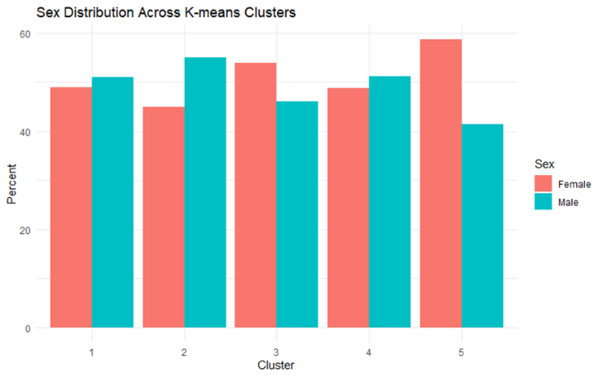
Cluster Profiles
Kmeans cluster | n | Mean age | Mean income pir | Mean bmi | Mean systolic bp | Mean diastolic bp | Mean hba1c
1 | 1317 | 49.38 | 4.62 | 27.81 | 120.37 | 72.13 | 5.59
2 | 314 | 60.29 | 2.17 | 32.51 | 129.50 | 69.73 | 9.23
3 | 1709 | 30.48 | 1.66 | 25.67 | 111.58 | 65.46 | 5.31
4 | 1598 | 66.01 | 1.89 | 27.80 | 141.16 | 75.24 | 5.85
5 | 890 | 43.77 | 1.90 | 40.97 | 125.59 | 74.69 | 5.74

Slide 40
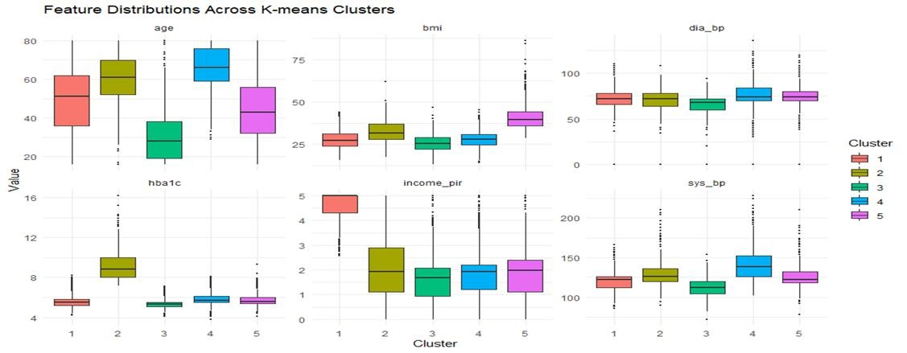
Profile Visualization

Slide 41
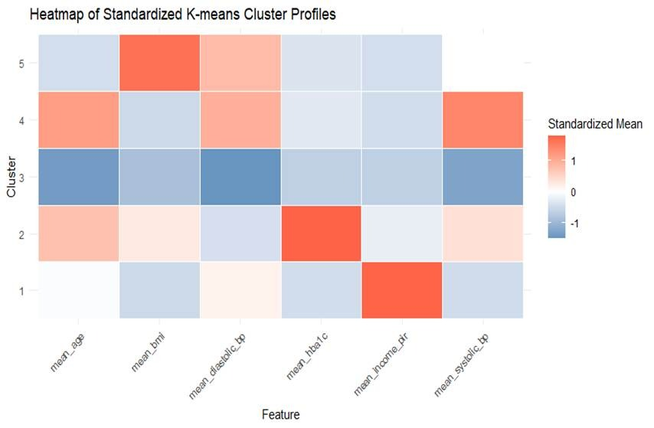
Profile Visualization

Slide 42
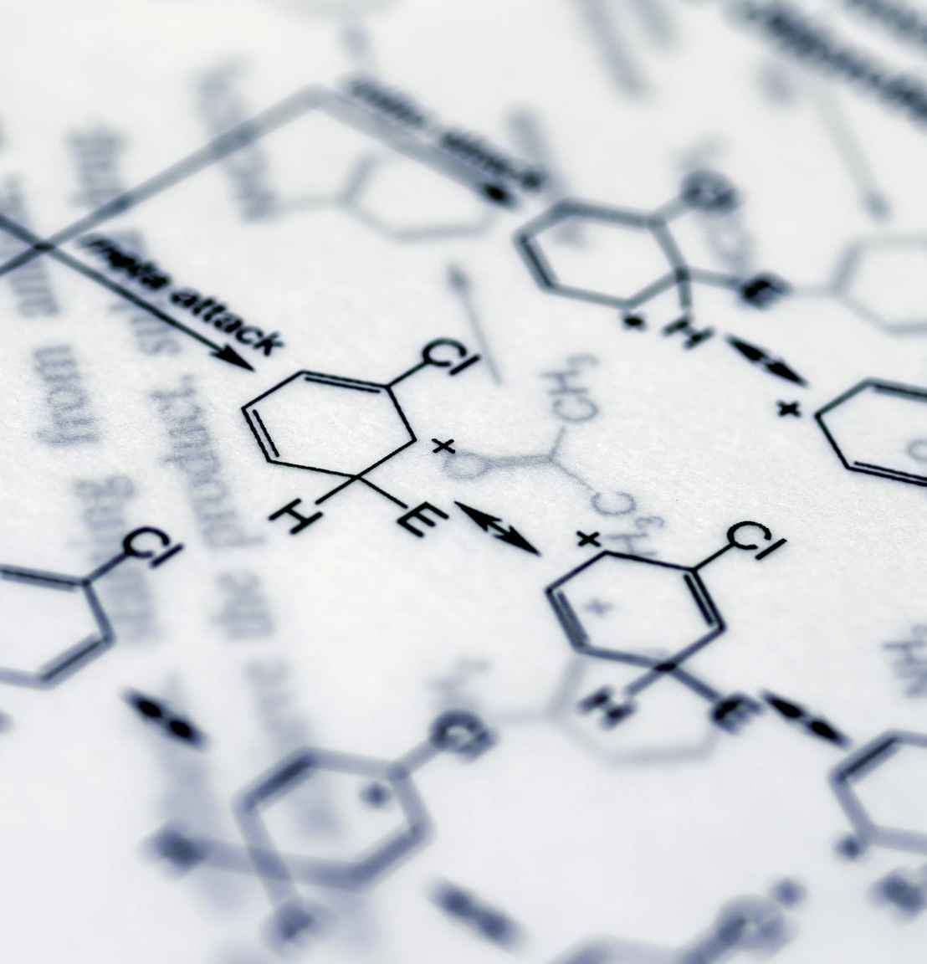
Conclusion
This project used K-means, DBSCAN, and Gaussian Mixture Models to identify health-related clusters in the NHANES dataset
Among the three methods, we determined the optimal method was our K-means model, balancing performance and interpretability
The five K-means clusters showed meaningful differences in age, income-to-poverty ratio, BMI, blood pressure, and HbA1c
These cluster profiles may help researchers and public health professionals identify groups that could benefit from more targeted prevention, screening, or intervention programs

Slide 43
THANK YOU

